Slide 1

Capstone Spring 2018 Midterm Report
Scott Merrill, Andrew Ekstedt, and Scott Russell

Slide 2
The Secret Bunny Team:
Privacy Preserving Cloud & Email Encryption
Notes:
SR

Slide 3

Privacy Preserving Cloud & Email Encryption
The ”Privacy Preserving Cloud, Email and Password Manager” Capstone project is a research-oriented project that aims to implement the DSSE scheme proposed by David Cash.
CC0 Creative Commons
No attribution required

Slide 4
Project Summary / Expo pitch
Equifax breach -> what happens if someone breaches google drive
Solution: searchable encryption
Store encrypted data on a server and be able to efficiently search it without the server knowing about it
We are comparing how fast encryption algorithms can search through an encrypted database

Slide 5
Progress Summary
Poster
Benchmarking
Large datasets
IM-DSSE
UI improvements
Expo prep
Demo
Web app?
Optimization
Pipack (Completed)
Ptr (In progress)
Lvl2 Ptr (In progress)

Slide 6
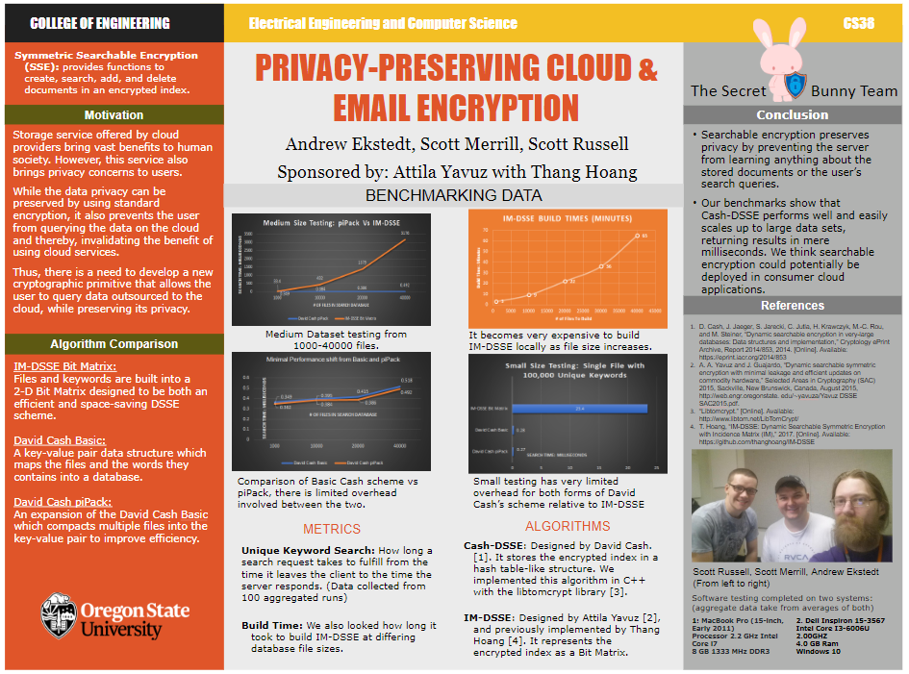

Slide 7
Requirements recap
Implement Cash-DSSE
Implement Client/Server
Implement Optimizations: packed, pointer, 2-level pointer
Benchmark against IM-DSSE

Slide 8
Code walkthrough / Demos
Core DSSE (AE)
Optimizations (SM)
Pack recap
Ptr - Code status and complications
Lvl2 - expected expansion
Benchmarks (SR)
Extras
Web app demo
UI optimizations

Slide 9
Benchmarking Hardware
Software testing completed on two systems: (Dell Laptop and Macbook Pro)
1. MacBook Pro
Processor 2.2 GHz Intel Core i7 Ram: 8 GB
OS X 10
2. Dell Inspiron
Processor 2.0 GHz Intel
Core i5
Ram: 4 GB
Windows 10
scott was here :)
Notes:
SR

Slide 10
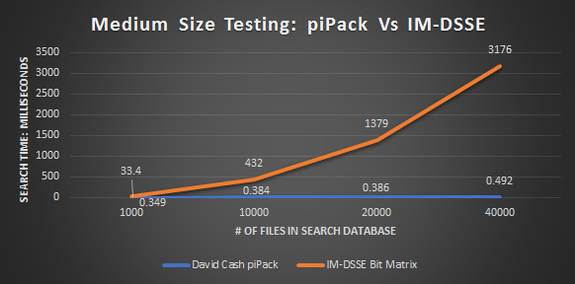
Benchmark Results
Notes:
SR

Slide 11
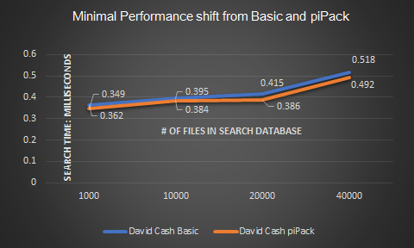
Benchmark Results: Continued
Notes:
SR

Slide 12
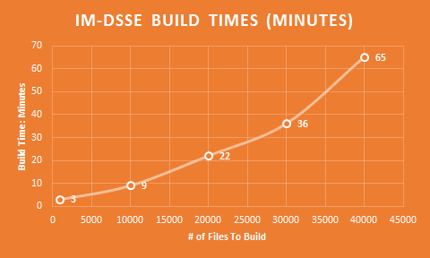
Benchmark Results: Continued
Notes:
SR

Slide 13
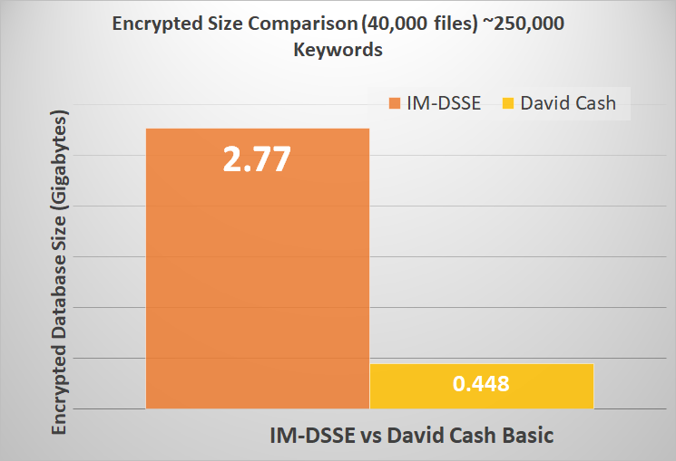
Benchmark Results: Continued
Notes:
SR

Slide 14
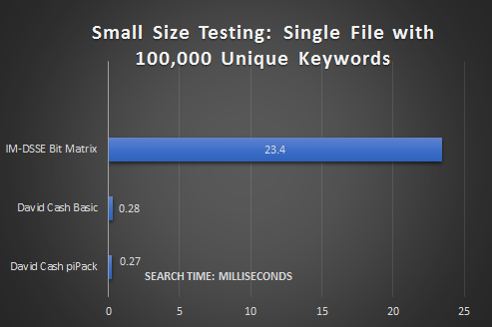
Benchmark Results: Continued
Notes:
SR

Slide 15
Requirements redux
Implement Cash-DSSE ✔
Implement Client/Server ✔
Implement Optimizations to Cash-DSS:
packed ✔, pointer (in-progress), 2-level pointer (in-progress)
Benchmark against IM-DSSE ✔
Small Database ✔
Medium Database ✔
Encrypted File Size Comparison ✔

Slide 16


Future Plans
Mentally Prepare for Expo
Wrap up optimization
Final Report Write Up
Web App Demo

Slide 17
fin

